Slide 1
Run Time
Chapter 16-16.2 inclusive

Slide 2
Topics
What is it
Main components
C++ compiler refresher
JVM
CIL
Mobile code/sandboxing

Slide 3

What is it
Run-time system: The core set of libraries required for the language to run
Compare to compiler
Generates intermediate/byte code

Slide 4
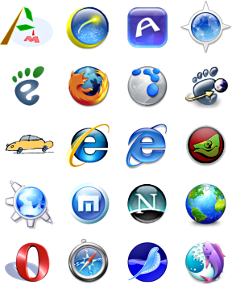
What is it
Run-time systems and compilers are Normally developed together
MANY languages have run-time systems written in other languages, and then use the run-time system’s compiler!
Case in point: HTML and the browser?

Slide 5

Main components
This in not all, nor are all required!
Garbage Collection
Variable Numbers of Arguments
Exception Handling
Event Handling
Coroutine & Thread Implementation
Remote Procedure Call
Transactional Memory
Dynamic Linking

Slide 6

C++ compilation model refresher
OK, why did C++ go this route…
Core concept: Compilers see a compilation unit - collection of source files
Linker: combine compilation units
Result: Developer can be in charge of file naming, organization And libraries work like any other bit of code

Slide 7
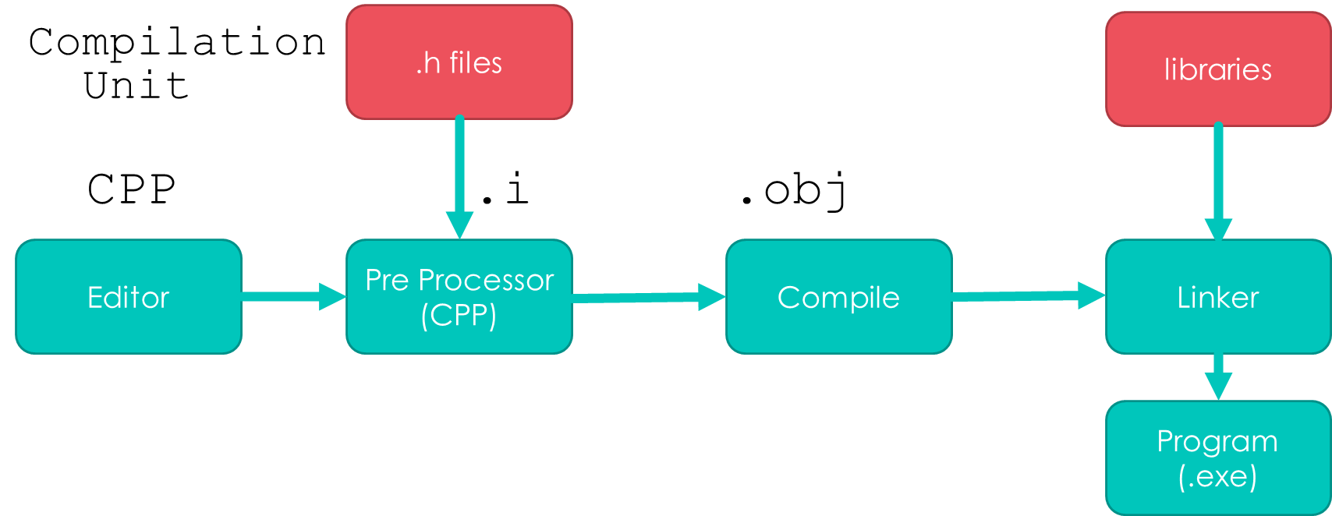
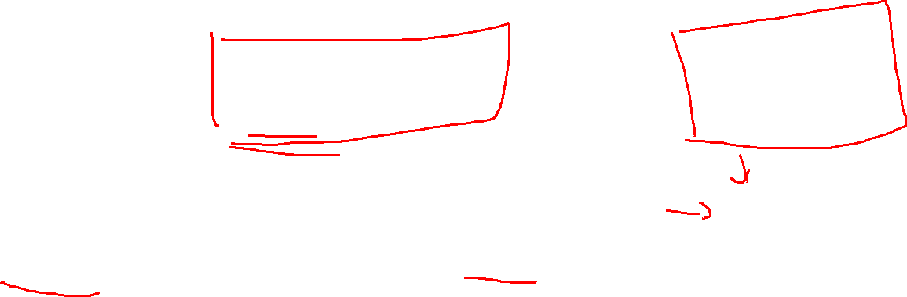
C++ compilation model revisited

Slide 8
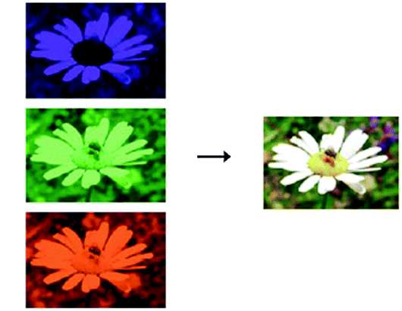

C Pre-Processor (CPP)?
Jobs:
handle macros (#define, NULL)
remove comments
replace #include "filename" or #include <filename> by contents of file
What’s the difference between angle brackets and double quotes?
#include <file> means look in standard directories
#include "file" means look at the current directory

Slide 9
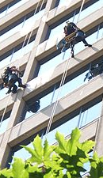
Build, versus clean build
Build tries to just recompile what has been change
As you can probably guess, with copying and pasting, that can go wrong from time to time
Clean build means start fresh by deleting all compiled “stuff”

Slide 10
Compilations model
Assembly, C, C++, Fortran
Slow start
Fast run
Best optimization on hardware
Direct access to hardware
Hard to de-compile (intellectual property)
Platform specific

Slide 11

QUESTION: How does this model handle….
Garbage Collection
Variable Numbers of Arguments
Exception Handling
Event Handling
Coroutine & Thread Implementation
Remote Procedure Call
Transactional Memory
Dynamic Linking

Slide 12
VMs and interpreted

Slide 13
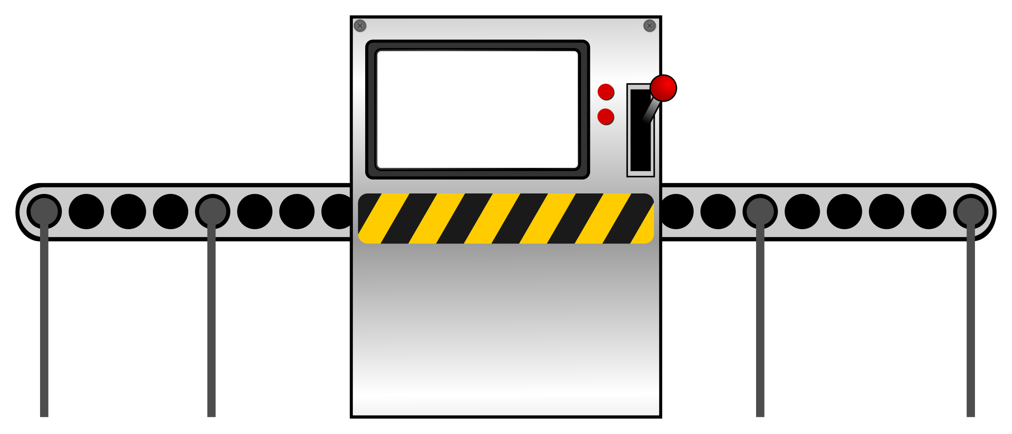

Virtual machine
Formally
A complete programming environment whose use is comparable to computer implemented with hardware
Two kinds
System VM
emulates all the hardware facilities of a standard OS
Process VM
emulates the environment needed by a single process

Slide 14

More on the JVM
Released in 1995 and entirely interpreted
Too slow for acceptance so…
JIT compiler added in 1998
Still slow though…

Slide 15

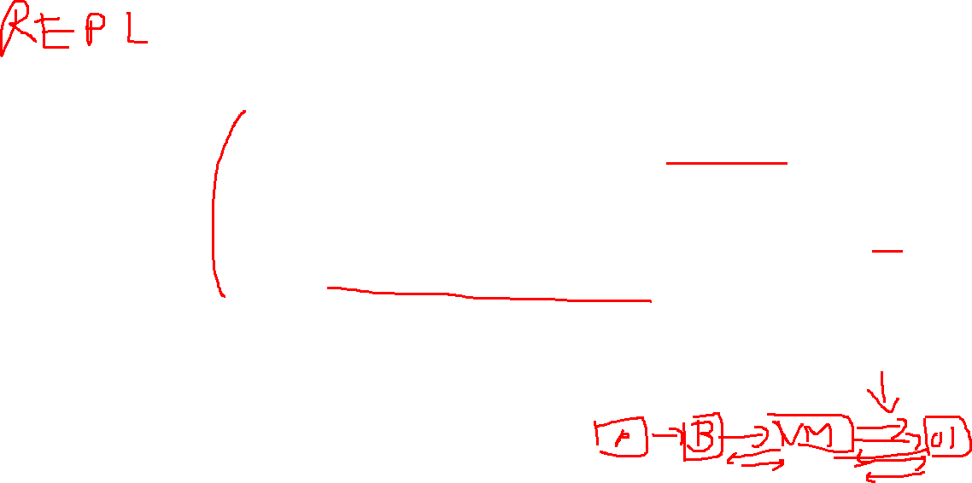
What exactly is JIT?
Just-in-Time (JIT)
Needed for Dynamic Compilation
JIT system compiles the line right before it is run
Add signiﬁcant delay to program the first run
Less so afterwards
Why?
Allows it to be compile to the current architecture!

Slide 16

More on the JVM
JVM is a process VM
Why?
Not a full computer OS
Includes
All built in data types
Type checking
built-in support for many of Java’s language features
Global constant pool
Set of registers
Stack for each thread
Etc.

Slide 17
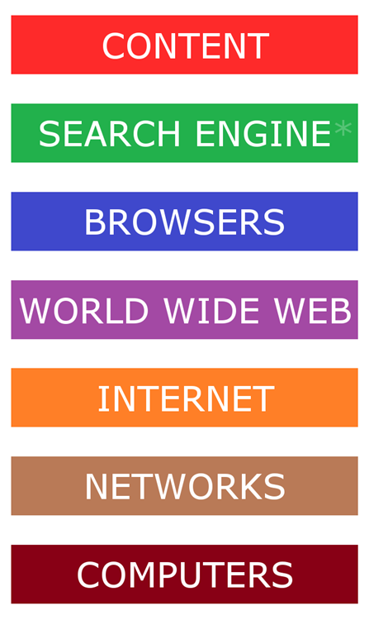
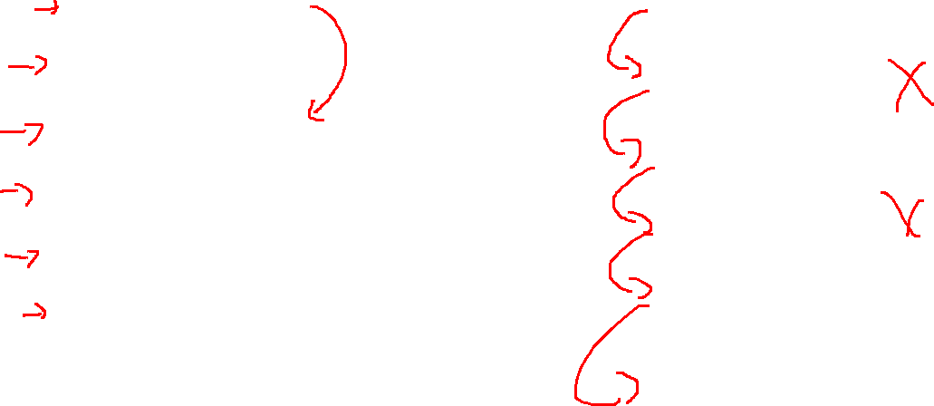
Comparison to Internet
Internet
VM
Code
Byte Code
Libraries
VM
OS
Computer

Slide 18
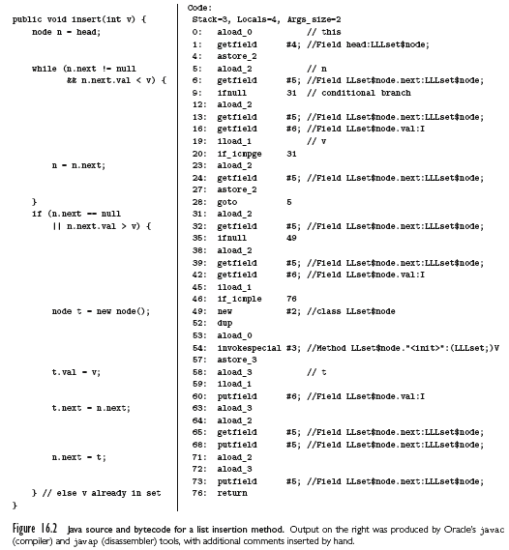
More on the JVM
Example LinkedList insert resulting byte code

Slide 19
QUESTION
VMs still need to run on machine hardware eventually. Byte code will not run. What generation of language is needed to code them?
machine (010100010)
Assembly
Low-level (e.g. c)
High level (e.g. c++, java)

Slide 20
Answer
Low-level (e.g. c)
Thus the increase in C projects!

Slide 21
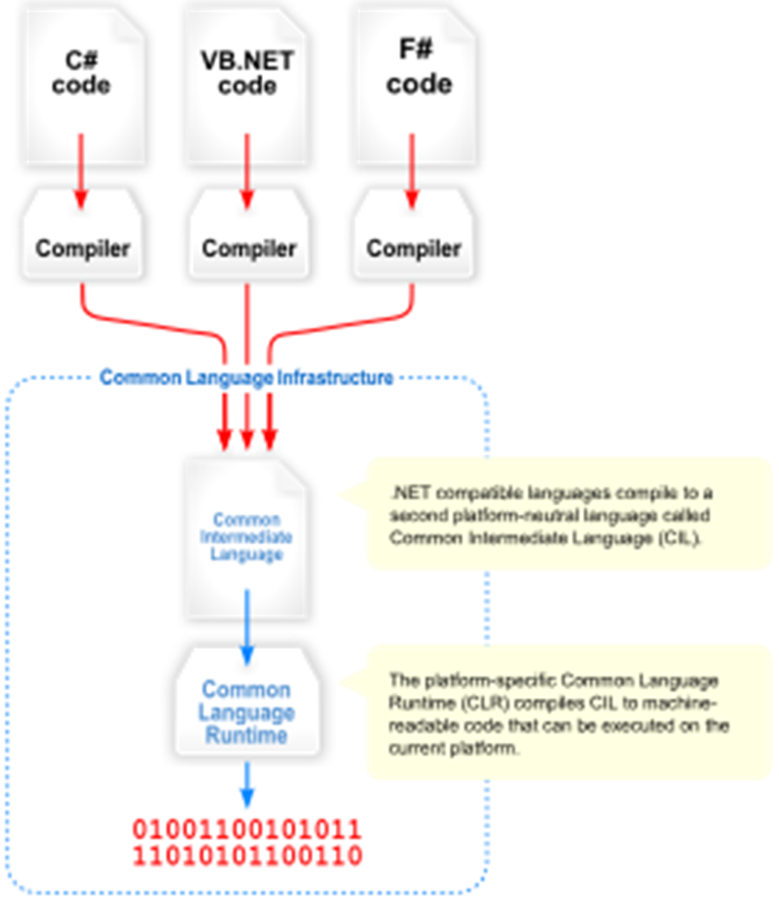
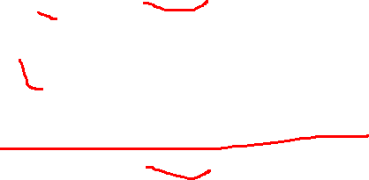
Java is familiar
But what about Microsoft?
CLI!!
Common Language Infrastuture
Standardized in 2001
Why?
Needed the many programming languages running on Windows to “play nice”

Slide 22
Comparison: Similarities
Multithreaded
Stack-based virtual machine
Garbage collection
Exception
Virtual method dispatch
Inheritance.
Platform-independent, self-descriptive, byte code notation.
Strong typing
Protection against overﬂow or underﬂow of the operand stack.

Slide 23

Comparison: Dissimilarities
More datatype in CLI
More function formats in CLI
Unsafe code made explicit in CLI

Slide 24
There ARE more byte codes
Python has the option to partially compile
Used
import py_compile py_compile.compile('hello1.py')
To compile the file containing
print( 'Hello, CSC461!' )

Slide 25
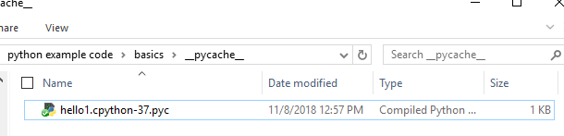
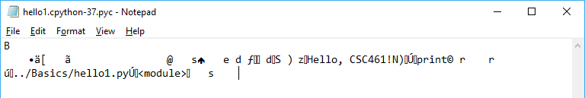
Result

Slide 26
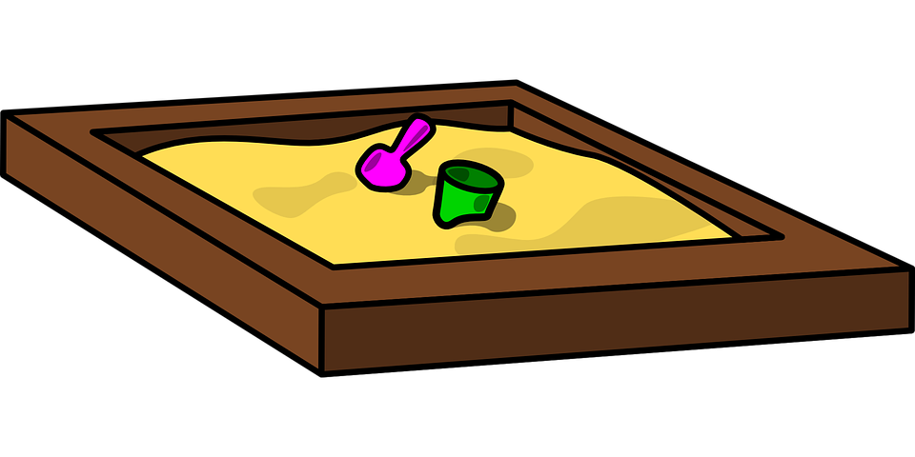
Mobile code and Sandboxing
Portability (mobility) is one of the main motivations for JIT
This requires a “sandbox”
Sandbox mechanisms are the interface between language implementation and OS

Slide 27
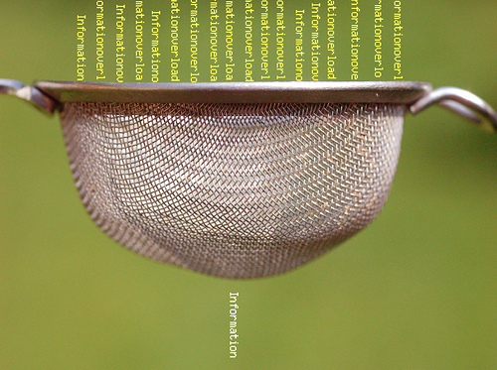

Sandboxing
Sandboxing normally only permits a very restricted memory location, and limited file access
In general the more powerful the sandbox, the less secure it is

Slide 28
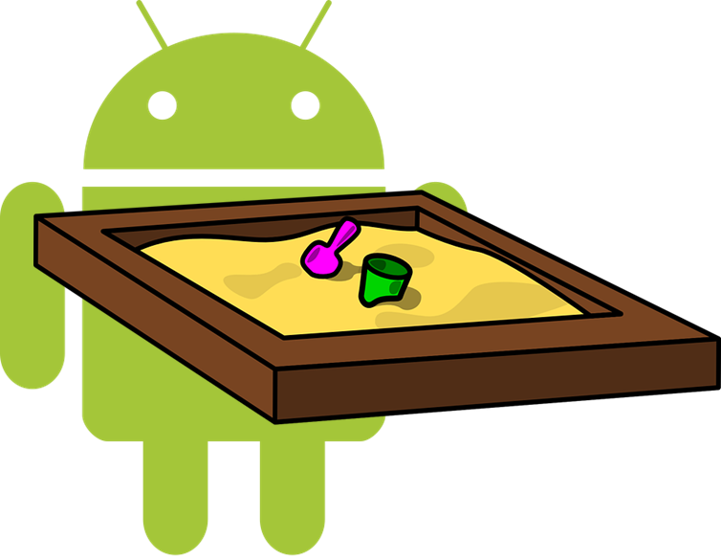
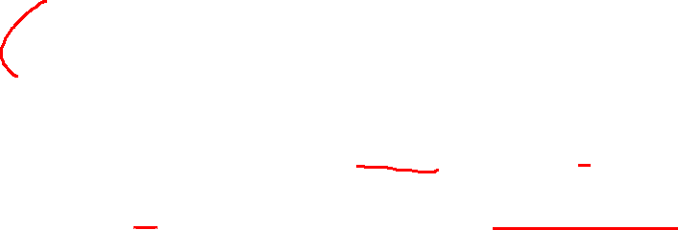
Sandboxing
Android is a good example
By default the only files an app can access are the ones it creates
Newer versions say it also can only automatically reopen file that were opened in that session!
There is a relatively easy work around in code

Slide 29
Summary
What is a run time environment
Comparison of common system
Sandboxing

